Slide 1

Internship Presentation
Padmam Surekha
Data Science & Business Analytics Intern
At The Sparks Foundation Company

Slide 2
INTRODUCTION
I am Padmam Surekha, B.Tech 3rd Year Student specialized in Computer Science studying at RGUKT-Srikakulam.
My skills includes Coding in python, Data Structures, HTML, CSS, JS, MYSQL, C language, Java, Machine Learning and Data Science.
I was appointed as a Data Science and Business Analytics intern at TSF [ The Sparks Foundation].
I worked there for 1 month completing the assigned tasks and received Internship completion certificate.

Slide 3

SELF ANALYSIS
This was my first internship in Data Science field
During this internship ,I got to improve my skills and work on live project by creating applications, coding the software and then executing them to get output.
Project Meetings, Reviews and other extra activities helped me to build more confidence in me and improved my communication skills.
Every member of TSF worked and encouraged each Intern to build skills and apply them in projects.

Slide 4
INTERNSHIP TASKS
It is a 1 Month Long internship at The Sparks Foundation company. It is a virtual Internship in which I worked on 3 assigned tasks and learned more about data pre-processing, cleaning, visualization and how machine learning helps data to get useful insights out of it.
• Applications Used are: Spyder, Power BI. • Technologies Used – Basic ML, Python Language and some Python Libraries like numpy, pandas, matplotlib, seaborn and Sklearn etc. • Content Link - https://github.com/SurekhaPadmam/Data-Science-Intern
Task-1: Prediction using Supervised Machine Learning
Task-2: Prediction using Unsupervised ML
Task-3: Exploratory Analysis using Dataset

Slide 5
1. Prediction Using Supervised ML
I as an intern have done the TASK 1 "Prediction Using Supervised ML".
The procedures is as follows:
1.Dataset Considered is: https://github.com/SurekhaPadmam/Data-Science-Intern/blob/main/task1/student- scores.csv
2.Imported the Database.
3.Splitted dataset into training set and testing set using sklearn.model_selection library.
4.Visualized the training set and testing set to understand easily.
5.Initialized the regression model and fitting it using training set (both X and Y).
6.Finally predicted the Y value for given X value( for given x -9.25 hrs, predicted the corresponding Y value)
the code is here: https://github.com/SurekhaPadmam/Data-Science-Intern/blob/main/task1/linearreg.py

Slide 6
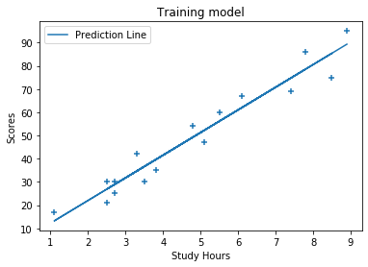
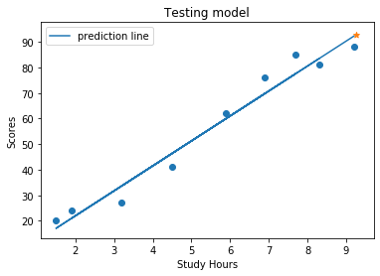
Task-1 Output: Visualization

Slide 7
2. Prediction Using Unsupervised ML
In this Prediction using unsupervised ML, i'm going to observe the datasets and predict the maximum optimum clusters there in dataset.
Dataset Used: Iris Dataset.
Application Used: Spyder
Programming Language: Python 3.8
First, Observe Dataset and
By using Elbow method, find out no of clusters.
Then using k-means clustering unsupervised ml algorithm, fit model
predict the output

Slide 8
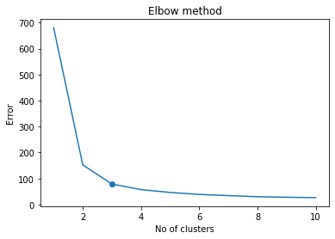
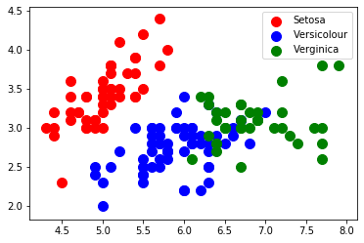
Task-2 Output: clusters visualization
3 Clusters

Slide 9
3. Exploratory Data Analysis
Task-3 is "Exploratory Data Analysis – using Retail dataset".
The procedures is as follows:
Dataset Considered is:https://github.com/SurekhaPadmam/Data-Science-Intern/blob/main/task3/SampleSuperstore.csv
Application Used for exploration: Power BI
Imported the dataset
done analysis using Power BI application.

Slide 10
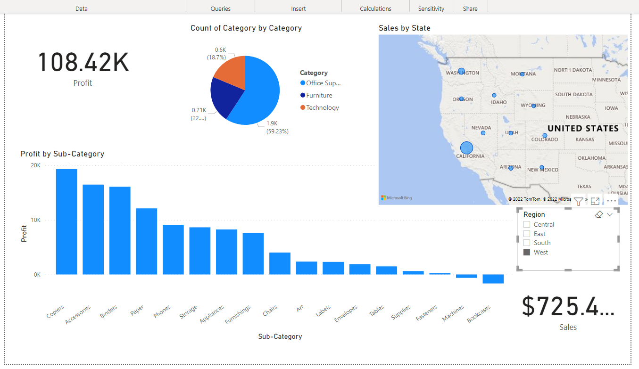
Task-3 Output:

Slide 11
What I learned From this Internship:
Firstly, I got a wonderful organization where I fit in beautifully and worked under good mentors.
The work environment was good, friendly, kind and respectful.
I got references ,worked with a beautiful team, met new people, people ahead of me, learned new and improved skills and how to apply them.
I learnt how to test out and develop all the skills that I got to know in college and see how they work.
Especially, Learned a lot about Time Management, Group Meetings, Project Reviews and Deadlines.
Learned more about data Pre-Processing, Cleaning, visualization and how machine learning helps data to get useful insights out of it.
New technologies I learned are: Python libraries like numpy, pandas, matplotlib, seaborn and sklearn.

Slide 12
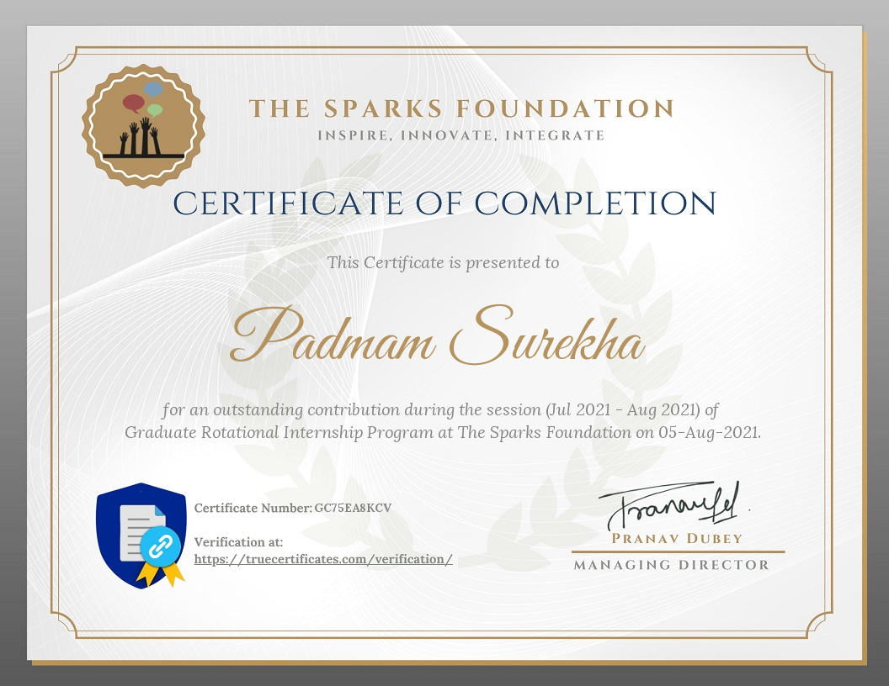

Slide 13
Thank You

